Slide 1

Flight Prices

Slide 2
Ho: There is a correlation between stops and duration with price.
Ha: there is not a correlation between stops and duration with price.

Slide 3
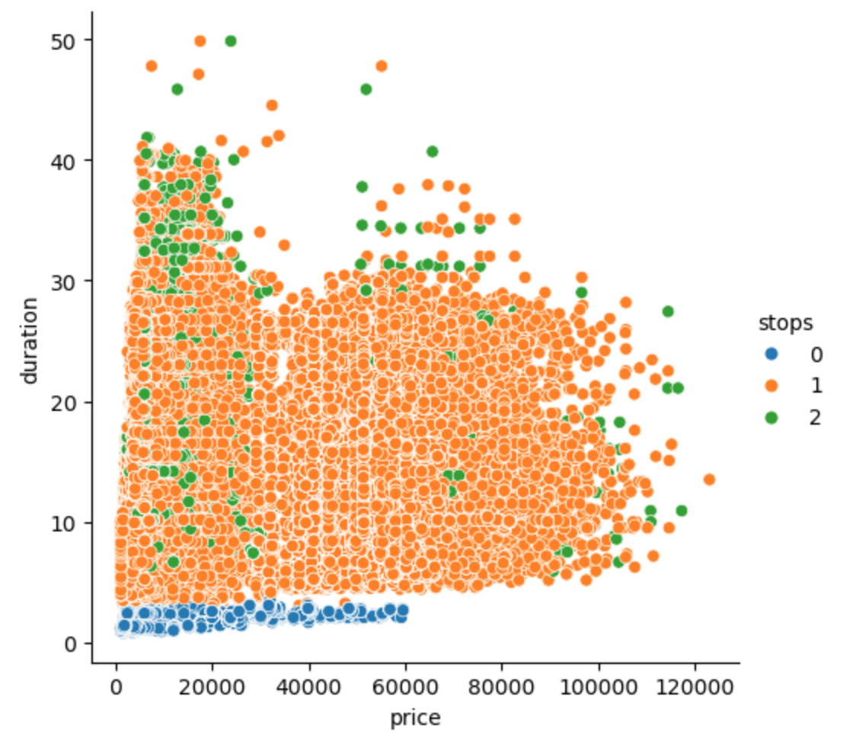
Here we can see the price associated with each flight with the duration and stops included.
We cant really gauge any insight into this graph so we will run a correlation matrix to see if there is any correlation.

Slide 4
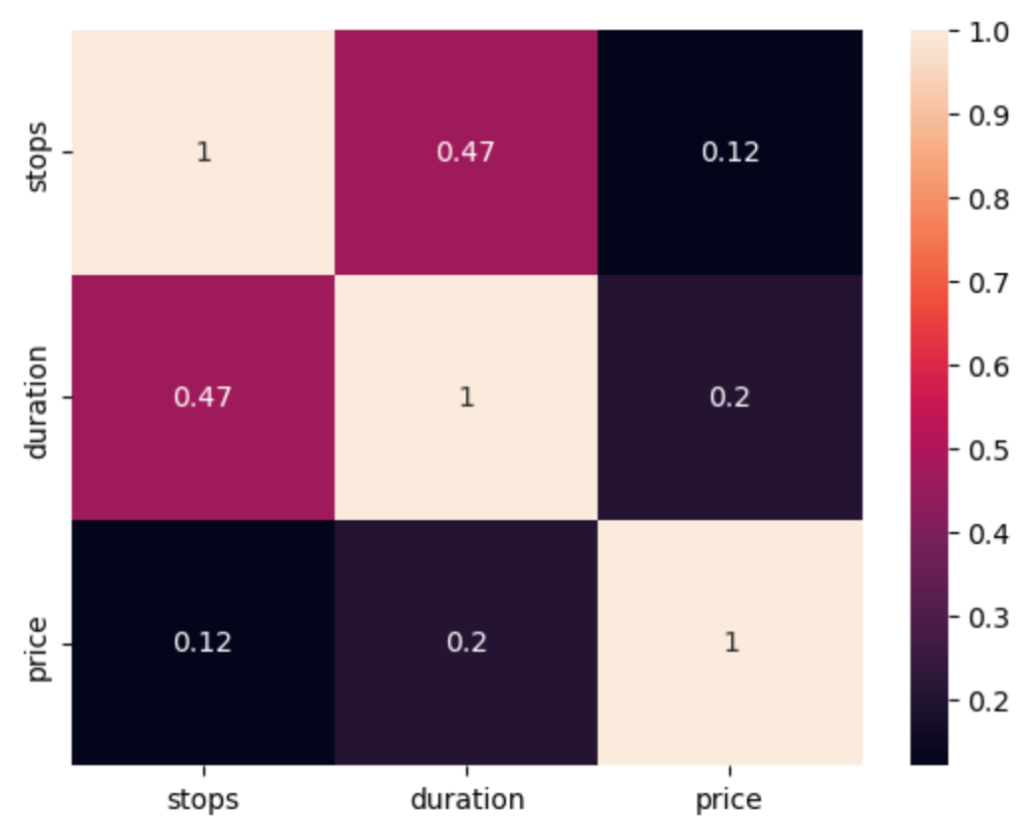
We can see from the correlation matrix that there is barely any if at all correlation between price/stops, and price/duration.
So our alternative hypothesis wins out.

